Slide 1
ENCRYPTION BASED SECURE MEDICAL IMAGE SHARING TECHNIQUE USING REVERSIBLE DATA HIDING AND DEEP LEARNING
MEMBERS: EKANATHAN S A
MADESH K
RAJASEKAR M
GUIDE: Ms. BLESSA BINOLIN PEPSI, ME(PhD)

Slide 2
AIM
To perform the encryption on image for secret Image Sharing.
To ensure the security of image sharing based on Chinese Remainder Theorem.
To predict the disease using Xception deep learning algorithm
Notes:
2

Slide 3
OBJECTIVES
To share high confidential images with an encryption technique using Chinese Remainder Theorem
The medical images can share with help this encryption technique
To ensure the security of transferred image.
To reduce the labor cost for disease prediction.

Slide 4
LITERATURE SURVEY
PROPOSED SYSTEM
A meaningful visually secure image encryption scheme based on compressive sensing and integer wavelet transform.
ADVANTAGES
In the proposed system the image transmitted with overlap the image with other image, so that no one can tap during transmission .
LIMITATIONS
This process take some energy to invest in wavelets to become able to choose the proper one for a specific image
A meaningful visually secure image encryption scheme -IEEE international conference on big data computing service - 2019

Slide 5
LITERATURE SURVEY
PROPOSED SYSTEM
A new image encryption algorithm based on two-dimensional Lorenz and Logistic. The encryption test of several classic images proves that the algorithm has high security and strong robustness
ADVANTAGES
The encryption algorithm has the characteristics of large secret key space, sensitivity to the key, small correlation coefficient and high contrast. In addition, the encryption algorithm is used. It can also resist noise attacks.
Image Encryption Algorithm Based on Logistic and Two-Dimensional Lorenz - IEEE Access on Emerging Approaches to Cyber Security

Slide 6
LITERATURE SURVEY
LIMITATIONS
The methods chosen to compute the parameters depend on the dynamics underlying the data and on the kind of analysis intended, which is in most cases highly complex and not always accurate.
Image Encryption Algorithm Based on Logistic and Two-Dimensional Lorenz - IEEE Access on Emerging Approaches to Cyber Security

Slide 7
LITERATURE SURVEY
PROPOSED SYSTEM
Model aims to provide security to the images using a combination of image encryption and image stitching techniques. The use of chaotic methods in the encryption makes it more difficult for the attackers to decrypt the image.
ADVANTAGES
Image stitching algorithm used on the receivers end makes it easy for him to generate the original image. Image encryption along with image stitching provides a double layer of protection to the image.
Image security using image encryption and image stitching - 2017 International Conference on Computing Methodologies and Communication (ICCMC)

Slide 8
LITERATURE SURVEY
LIMITATIONS
A person with a single part or two parts of the image will not be able to use that image
Image security using image encryption and image stitching - 2017 International Conference on Computing Methodologies and Communication (ICCMC)

Slide 9
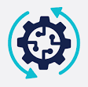
OVERALL WORK FLOW
Finding Prime number for CRT
Encryption
Image Sharing
Retrieval of Original Image
Decryption

Slide 10
BLOCK DIAGRAM
Dealer
Shareholder 1
SIS key 1
Image share 1
Shareholder’ 1
SIS key’ 1
Image share’ 1
Image
Sharing
Dealer
Any t
shareholders
Image
Sharing
Shareholder 2
SIS key 2
Image share 2
Shareholder’ 2
SIS key’ 2
Image share’ 2
Image
Image
reconstructing
Image
Image
Sharing
Shareholder t
SIS key t
Image share t
Shareholder’ t
SIS key’ t
Image share’ t

Slide 11
Our Proposed Block Diagram
Finding Prime number for CRT
Encryption
Image Sharing
Decryption
Learnable Image Prediction
Xception Net
Retrieval of Original Image

Slide 12
SECRET SHARING SCHEME BASED ON CRT
Parameter Generation
Secret Sharing
Secret Reconstruction
Homomorphic addition

Slide 13
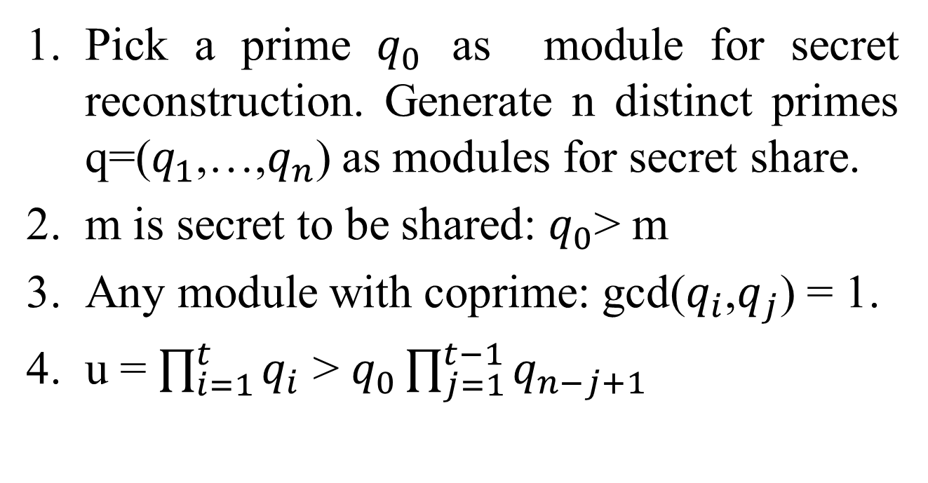
PARAMETER GENERATION
Pick a prime $q_{0}$ as module for secret reconstruction. Generate n distinct primes q=($q_{1}$,…,$q_{n}$) as modules for secret share.
m is secret to be shared: $q_{0}$> m
Any module with coprime: gcd($q_{i}$,$q_{j}$) = 1.
u = $\prod_{i=1}^{t}{q_{i}}$>$q_{0}\prod_{j=1}^{t−1}{q_{n−j+1}}$

Slide 14
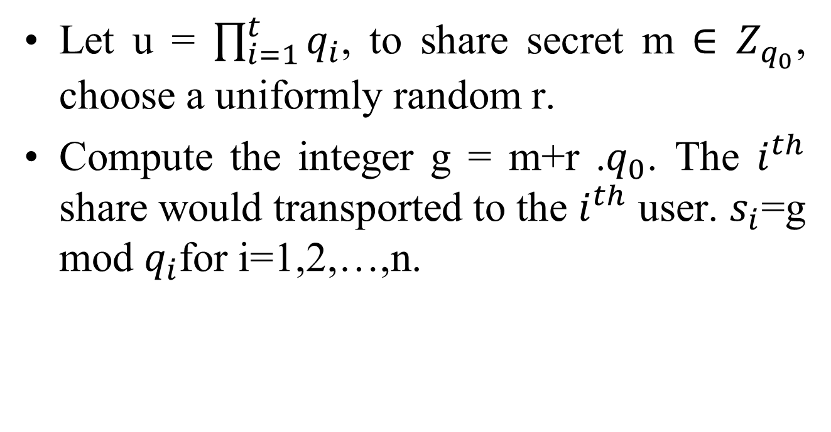
SECRET SHARING
Let u = $\prod_{i=1}^{t}{q_{i}}$, to share secret m $∈Z_{q_{0}}$, choose a uniformly random r.
Compute the integer g = m+r .$q_{0}$. The $i^{th}$ share would transported to the $i^{th}$ user. $s_{i}$=g mod $q_{i}$for i=1,2,…,n.

Slide 15
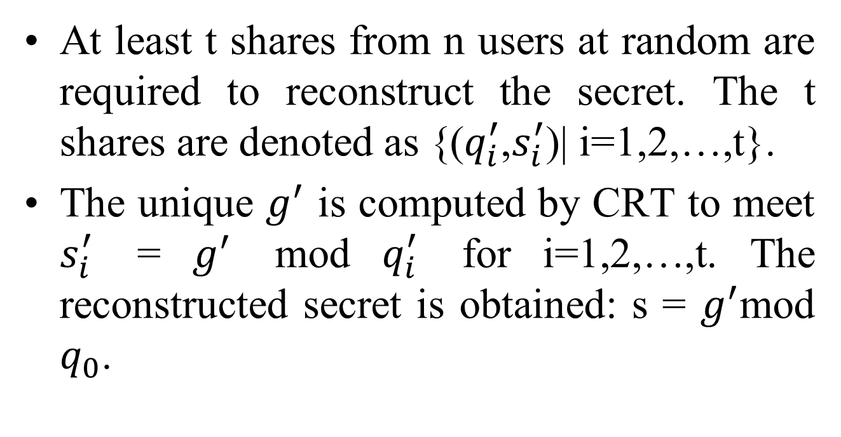
SECRET RECONSTRUCTION
At least t shares from n users at random are required to reconstruct the secret. The t shares are denoted as {($q_{i}^{′}$,$s_{i}^{′}$)| i=1,2,…,t}.
The unique $g^{′}$ is computed by CRT to meet $s_{i}^{′}$ = $g^{′}$ mod $q_{i}^{′}$ for i=1,2,…,t. The reconstructed secret is obtained: s = $g^{′}$mod $q_{0}$.

Slide 16
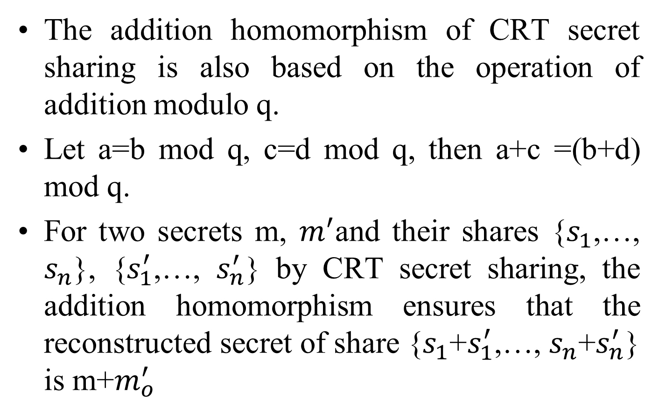
HOMOMORPHIC ADDITION
The addition homomorphism of CRT secret sharing is also based on the operation of addition modulo q.
Let a=b mod q, c=d mod q, then a+c =(b+d) mod q.
For two secrets m, $m^{′}$and their shares {$s_{1}$,…,$s_{n}$}, {$s_{1}^{′}$,…,$s_{n}^{′}$} by CRT secret sharing, the addition homomorphism ensures that the reconstructed secret of share {$s_{1}$+$s_{1}^{′}$,…, $s_{n}$+$s_{n}^{′}$} is m+$m_{o}^{′}$

Slide 17
MODULES
Framework and Notation
Parameter Setting and Key Distribution
Homomorphic Difference Expansion in Encrypted Domain

Slide 18
MODULE DESCRIPTION
An Image in encrypted using CRT and that image is shared among different shareholders.
That shared image is collected from the shareholders and decrypt those image to get the original image

Slide 19
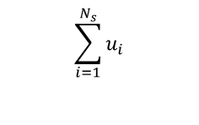
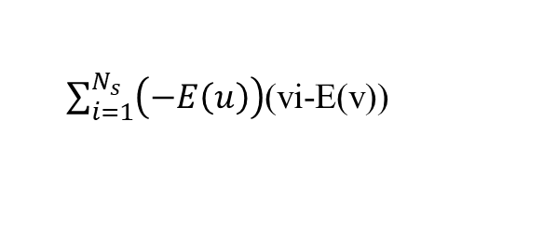
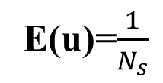

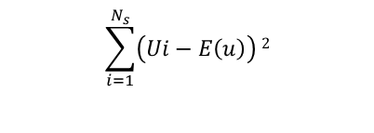
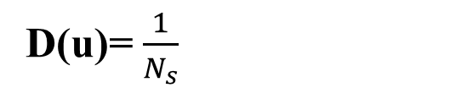
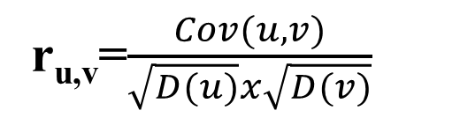
FORMULAE USED
E(u)=$\frac{1}{N_{s}}$
$$\sum_{i=1}^{N_{s}}{u_{i}}$$
Horizontal and vertical correlation
$$\sum_{i=1}^{N_{s}}{\left(Ui−E\left(u\right)\right)}2$$
D(u)= $\frac{1}{N_{s}}$
Diagonal Correlation
covariance of u,v
Cov(u,v)= $\frac{1}{N_{s}}$
$\sum_{i=1}^{N_{s}}{\left(−E\left(u\right)\right)}$(vi-E(v))
r_{u,v}=$\frac{Cov(u,v)}{\sqrt{D(u)}x\sqrt{D(v)}}$
Correlation coefficient

Slide 20
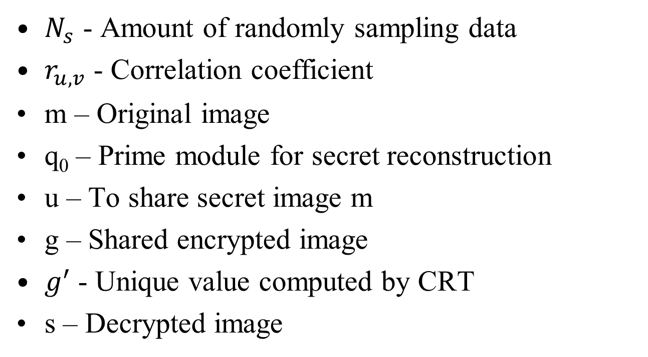
DESCRIPTION
$N_{s}$ - Amount of randomly sampling data
$r_{u,v}$ - Correlation coefficient
m – Original image
q₀ – Prime module for secret reconstruction
u – To share secret image m
g – Shared encrypted image
$g^{′}$- Unique value computed by CRT
s – Decrypted image

Slide 21
Framework and Notation
In the application of secret image sharing, there are n different shareholders and a dealer of the system.
The dealer owns the content of the secret image and is supposed to set SIS system parameters, generate and distribute primes as the SIS key to each shareholder.
The shareholder i is distributed the SIS key i in advance (i=1, 2,..., n). To calculate the image share i, the dealer must receive the shareholder i' SIS key, and input the key together with the image into image sharing function.

Slide 22
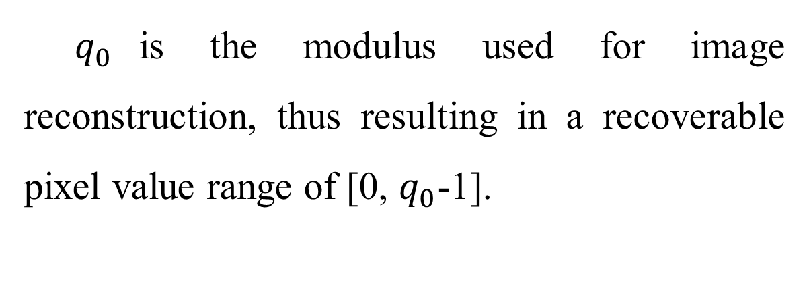
Parameter Setting and Key
Distribution
$q_{0}$is the modulus used for image reconstruction, thus resulting in a recoverable pixel value range of [0, $q_{0}$-1].

Slide 23
Homomorphic Difference Expansion in Encrypted Domain
The purpose of HDE-ED is to ensure that
the reconstructed image would carry additional data through certain homomorphic processing on the image shares of the n shareholders.
The original image could be recovered from the reconstructed marked image.

Slide 24
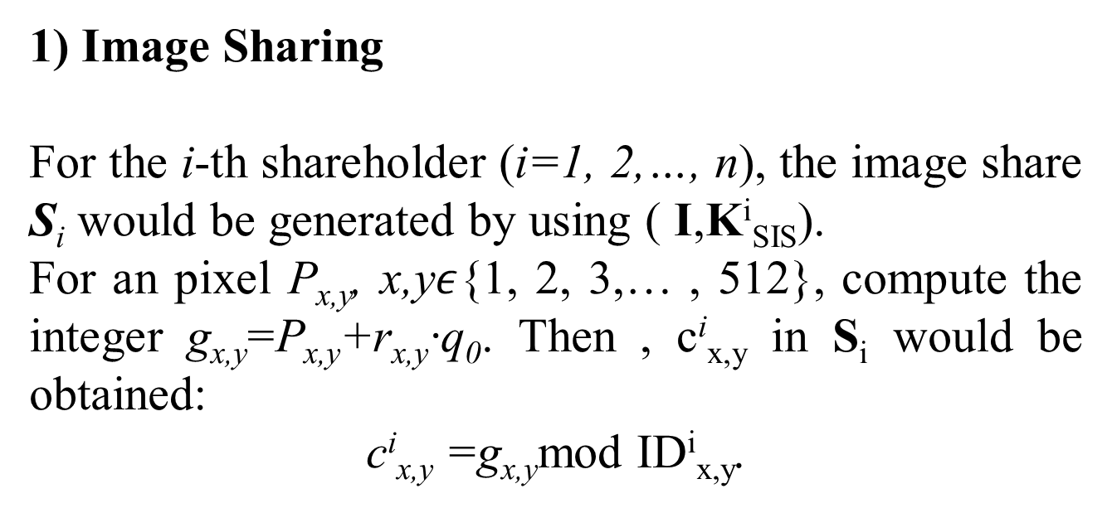
1) Image Sharing
For the i-th shareholder (i=1, 2,…, n), the image share S_{i} would be generated by using ( I,K^{i}_{SIS}).
For an pixel P_{x,y}, x,y$ε${1, 2, 3,… , 512}, compute the integer g_{x,y}=P_{x,y}+r_{x,y}·q₀. Then , c^{i}_{x,y} in S_{i} would be obtained:
c^{i}_{x,y} =g_{x,y}mod ID^{i}_{x,y}.

Slide 25
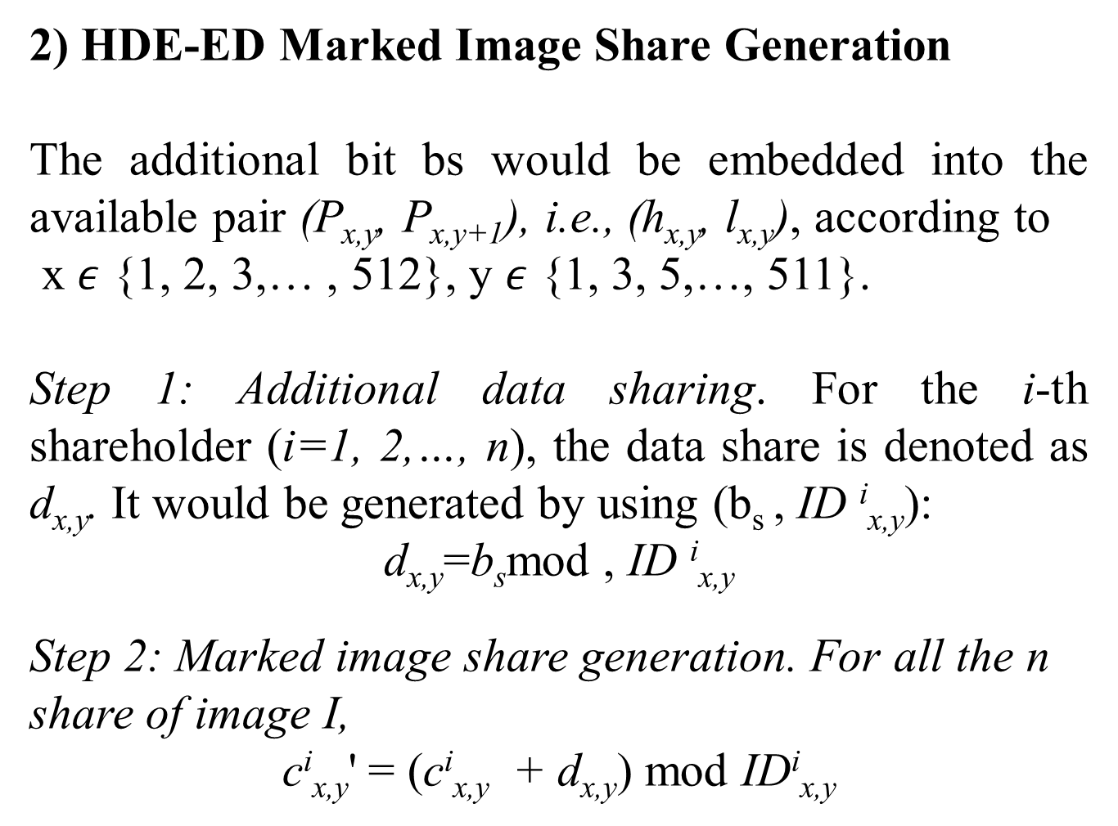
2) HDE-ED Marked Image Share Generation
The additional bit bs would be embedded into the available pair (P_{x,y}, P_{x,y+1}), i.e., (h_{x,y}, l_{x,y}), according to
x $ε$ {1, 2, 3,… , 512}, y $ε$ {1, 3, 5,…, 511}.
Step 1: Additional data sharing. For the i-th shareholder (i=1, 2,…, n), the data share is denoted as d_{x,y}. It would be generated by using (b_{s} , ID ^{i}_{x,y}):
d_{x,y}=b_{s}mod , ID ^{i}_{x,y}
Step 2: Marked image share generation. For all the n share of image I,
c^{i}_{x,y}' = (c^{i}_{x,y} + d_{x,y}) mod ID^{i}_{x,y}

Slide 26
where i =1, 2, …, n.
For all the available pairs, each pair would carry one bit additional data by repeating the operations.The i-th shareholder would obtain HDE-ED marked share S_{i} ' (i=1, 2, …, n).

Slide 27
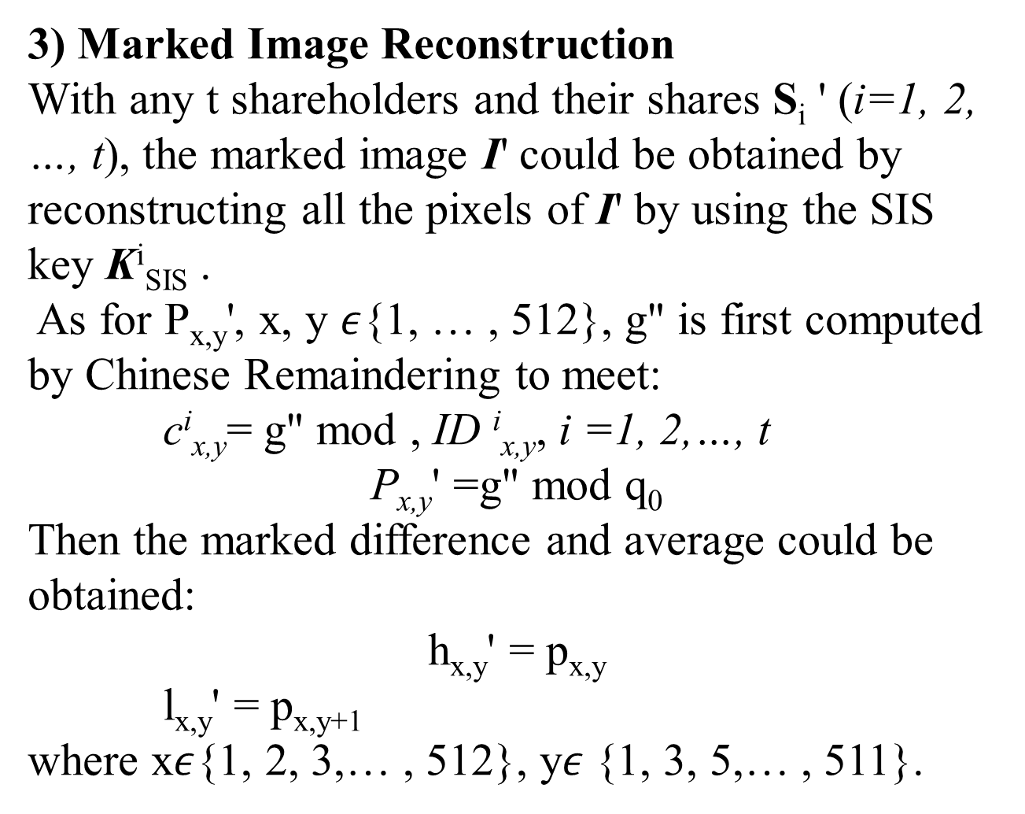
3) Marked Image Reconstruction
With any t shareholders and their shares S_{i} ' (i=1, 2, …, t), the marked image I' could be obtained by reconstructing all the pixels of I' by using the SIS key K^{i}_{SIS} .
As for P_{x,y}', x, y $ε${1, … , 512}, g" is first computed by Chinese Remaindering to meet:
c^{i}_{x,y}= g" mod , ID ^{i}_{x,y}, i =1, 2,…, t
P_{x,y}' =g" mod q₀
Then the marked difference and average could be obtained:
h_{x,y}' = p_{x,y}
l_{x,y}' = p_{x,y+1}
where x$ε${1, 2, 3,… , 512}, y$ε${1, 3, 5,… , 511}.

Slide 28
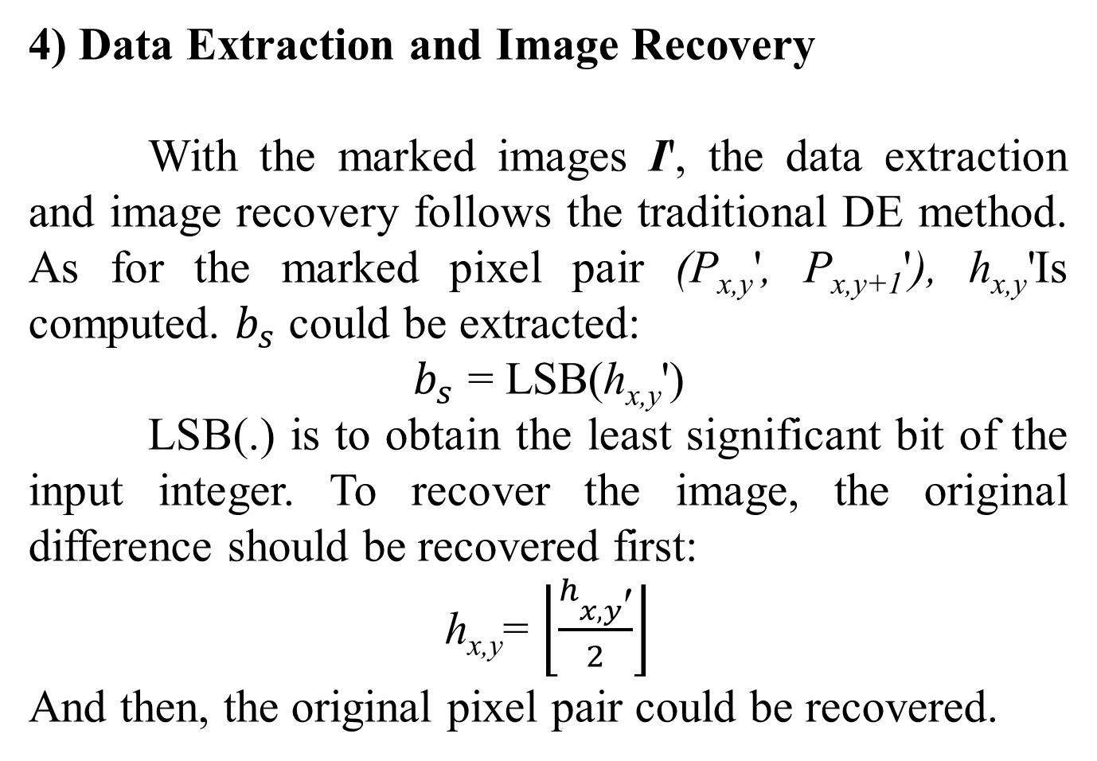
4) Data Extraction and Image Recovery
With the marked images I', the data extraction and image recovery follows the traditional DE method. As for the marked pixel pair (P_{x,y}', P_{x,y+1}'), h_{x,y}'Is computed. $b_{s}$ could be extracted:
$b_{s}$ = LSB(h_{x,y}')
LSB(.) is to obtain the least significant bit of the input integer. To recover the image, the original difference should be recovered first:
h_{x,y}= $\left\lfloor \frac{h_{x,y\text{′}}}{2}\right\rfloor$
And then, the original pixel pair could be recovered.

Slide 29
PROPOSED IMAGE ENCRYPTION
SKK SCHEME WITH STATISTICAL
SMOOTHING:
The encryption scheme is enlightened by the original SKK scheme. Thus, the negative-positive transformation and color shuffling operation are included in this scheme.
After completing all the steps in the original SKK scheme, we added up the process of statistical smoothing into the images.

Slide 30
STATISTICAL FILTER USED:
median filter.
mean filter.
maximum filter.
minimum filter.
which aim to fill all elements of a block with its median, mean, maximum, and minimum values respectively.

Slide 31
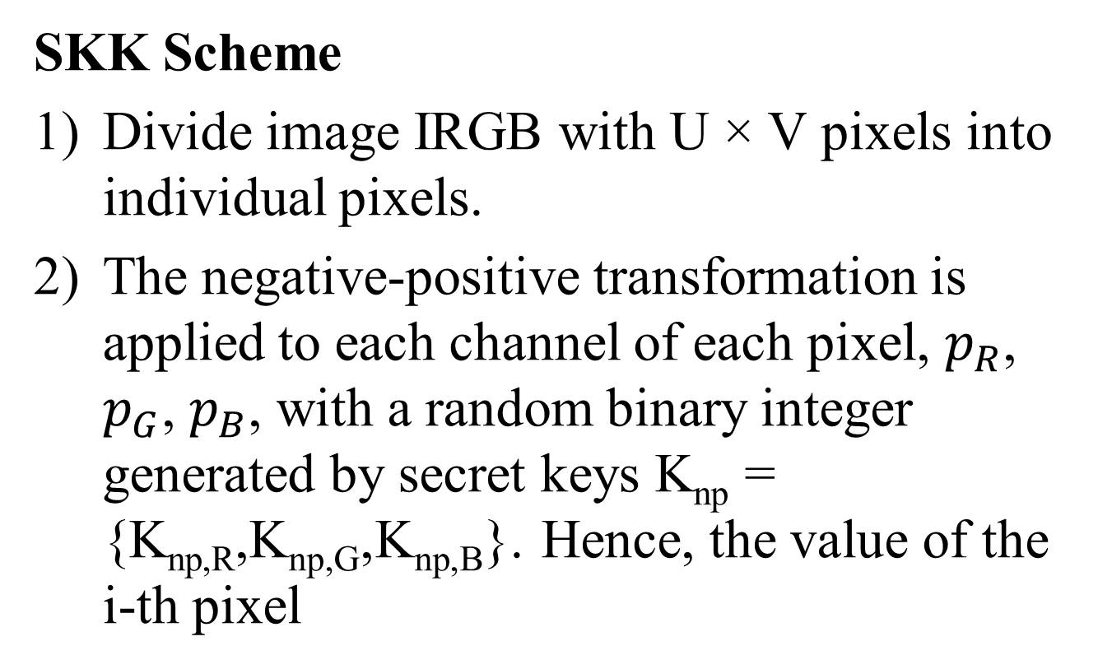
PROCEDURE FOR APPLYING MAXIMUM FILTER:
SKK Scheme
Divide image IRGB with U × V pixels into individual pixels.
The negative-positive transformation is applied to each channel of each pixel, $p_{R}$, $p_{G}$, $p_{B}$, with a random binary integer generated by secret keys K_{np} = {K_{np,R},K_{np,G},K_{np,B}}. Hence, the value of the i-th pixel

Slide 32
The idea of applying a max filter on 3x3 block
1 | 2 | 3
4 | 5 | 6
7 | 8 | 9
9 | 9 | 9
9 | 9 | 9
9 | 9 | 9
Max Filtering

Slide 33
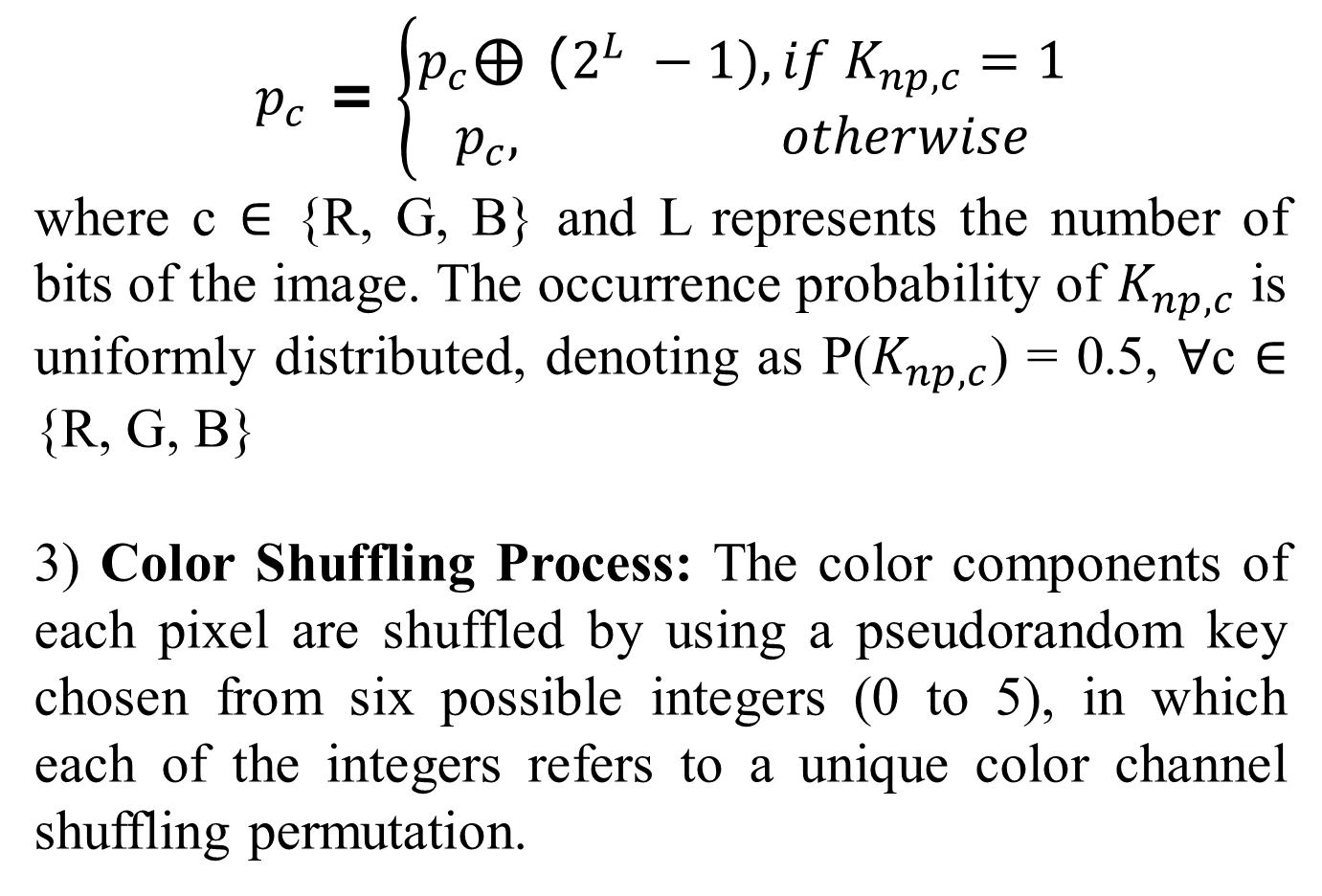
$p_{c}$ = $\left\{\begin{aligned}p_{c}\text{⊕}\text{ (}2^{L} −1), if K_{np,c}=1 \\ p_{c}, otherwise\end{aligned}\right.$
where c ∈ {R, G, B} and L represents the number of bits of the image. The occurrence probability of $K_{np,c}$ is uniformly distributed, denoting as P($K_{np,c}$) = 0.5, ∀c ∈ {R, G, B}
3) Color Shuffling Process: The color components of each pixel are shuffled by using a pseudorandom key chosen from six possible integers (0 to 5), in which each of the integers refers to a unique color channel shuffling permutation.

Slide 34
Proposed scheme for Image Encryption
Divide UxV
Pixels into pixels
Neagative-Positive
transformation
M x M Block
Based statistical
Smoothing
Color Shuffling
Key for colour shuffling
Key for statistical smoothing
4) After all the steps dictated above have been processed, the image IRGB is split into blocks with sized M × M.

Slide 35
TRAINING PROCESS (kfold = 5)
Fold 1
Fold 2
Fold 3
Fold 4
Fold 5
- Training set
- Validation set

Slide 36
XCEPTION PROCESS

Slide 37
XCEPTION PROCESS
1. Entry flow: This is the initial stage of the Xception network where the input image is processed by a series of convolutional and pooling layers to extract basic features from the image. The entry flow consists of several parallel convolutional blocks that extract different types of features at different scales.
2. Middle flow: After the features are extracted in the entry flow, they are passed through a series of middle flow modules. These modules contain multiple residual blocks that help to increase the depth of the network and improve its accuracy.
3. Exit flow: In the final stage of the Xception network, the features are aggregated and passed through a series of fully connected layers to make a prediction. The exit flow contains a combination of global average pooling and fully connected layers, which help to reduce the number of parameters in the network and prevent overfitting.

Slide 38
ALGORITHM CRT:
Generate a list of random prime numbers.
Choose two random prime numbers m1 and m2 from the list.
Calculate M = m1 * m2.
Calculate M1 = M / m1 and M2 = M / m2.
Find the inverse of M1 and M2 modulo m1 and m2, respectively, and store them in Z1 and Z2.
Use the Chinese remainder theorem to encrypt images.
Implement homomorphic addition by merging two images into one.
Read the image files and convert them into arrays of pixels.
Generate random polynomials for each pixel in the image.
Evaluate these polynomials at n different points to obtain n different shares.
Encrypt each share using the SIS key (M1, M2, Z1, Z2).
Combine the encrypted shares using homomorphic addition to obtain the encrypted image.
Decrypt the encrypted image by decoding the shares using Lagrange interpolation.

Slide 39
CODE
Chinese Remainder Theorem
CODE\CRT.ipynb
ML – Xception deep learning algorithm
CODE\Xception_MIS.ipynb
Dense-Net
CODE\Dense_CRT.ipynb
CRT – Analysis
CODE\Analysis_CRT.ipynb
CRT – Alex
CODE\CRT_Alex.ipynb
GoogleNet
CODE\GoogleNet.ipynb
ResNet
CODE\ResNet18.ipynb

Slide 40
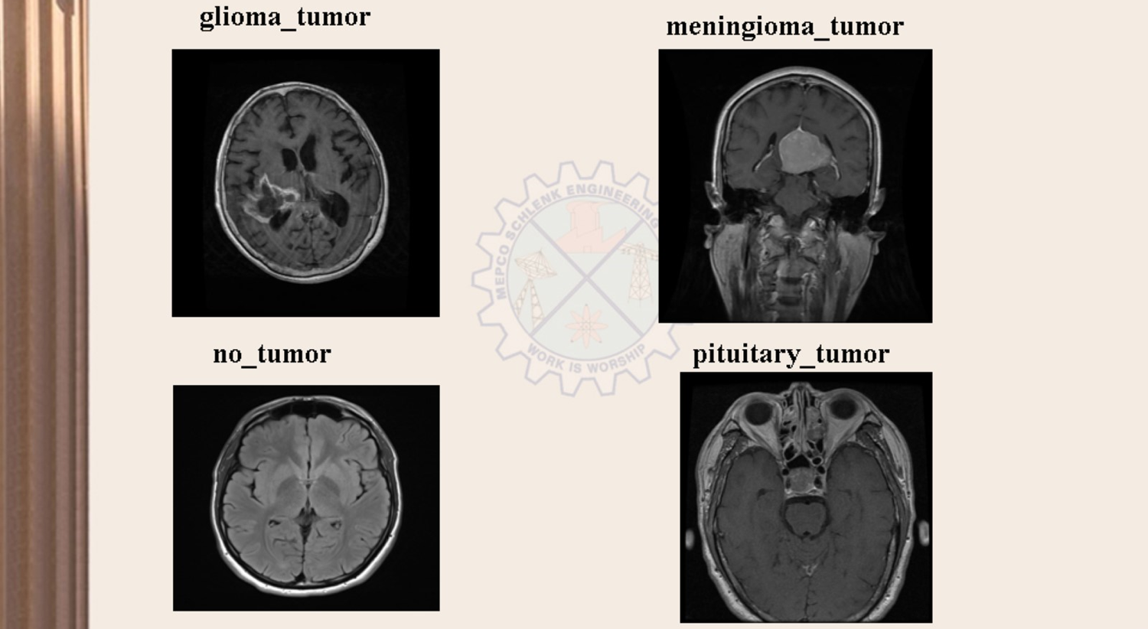
DATA SET – Brain Tumor

Slide 41

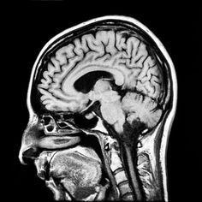
INPUT IMAGE
COVER IMAGE
ORIGINAL IMAGE

Slide 42
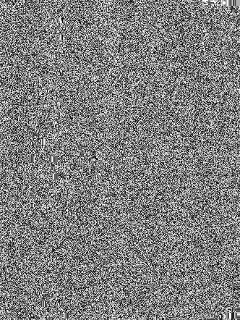
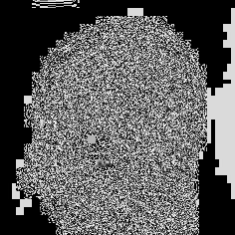
ENCRYPTED IMAGE
COVER IMAGE
ORIGINAL IMAGE

Slide 43
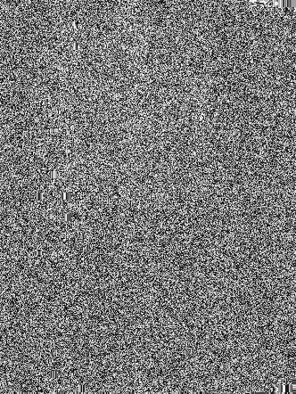
IMAGE TO BE SHARED

Slide 44
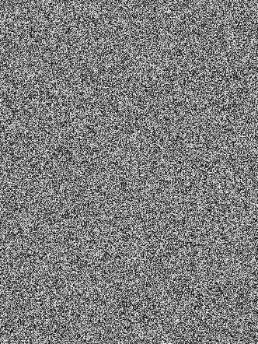






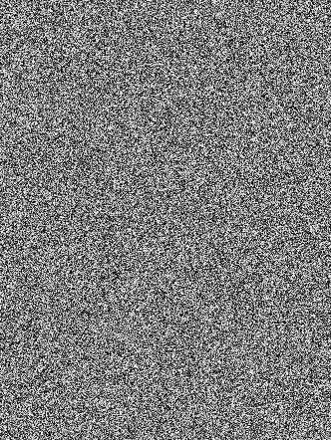

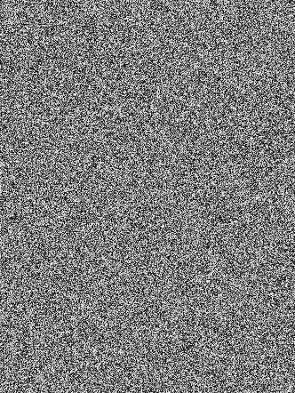
IMAGE OF 10 SHARES
SHARE 1
SHARE 2
SHARE 3
SHARE 4
SHARE 5
SHARE 6
SHARE 7
SHARE 8
SHARE 9
SHARE 10

Slide 45
DECRYPTED IMAGE
COVER IMAGE
ORIGINAL IMAGE

Slide 46
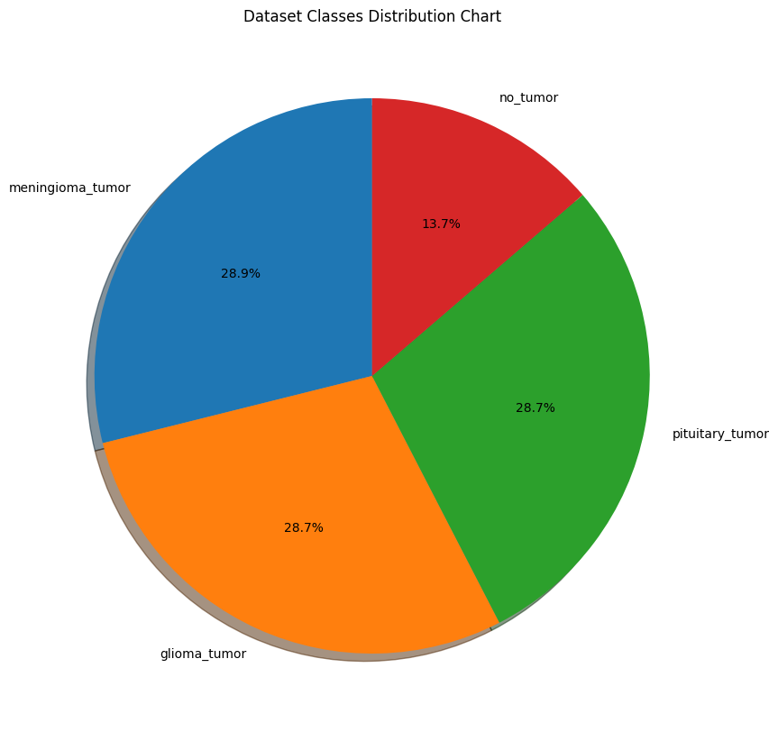
VISUALIZATION OF BRAIN TUMOR DATASET

Slide 47
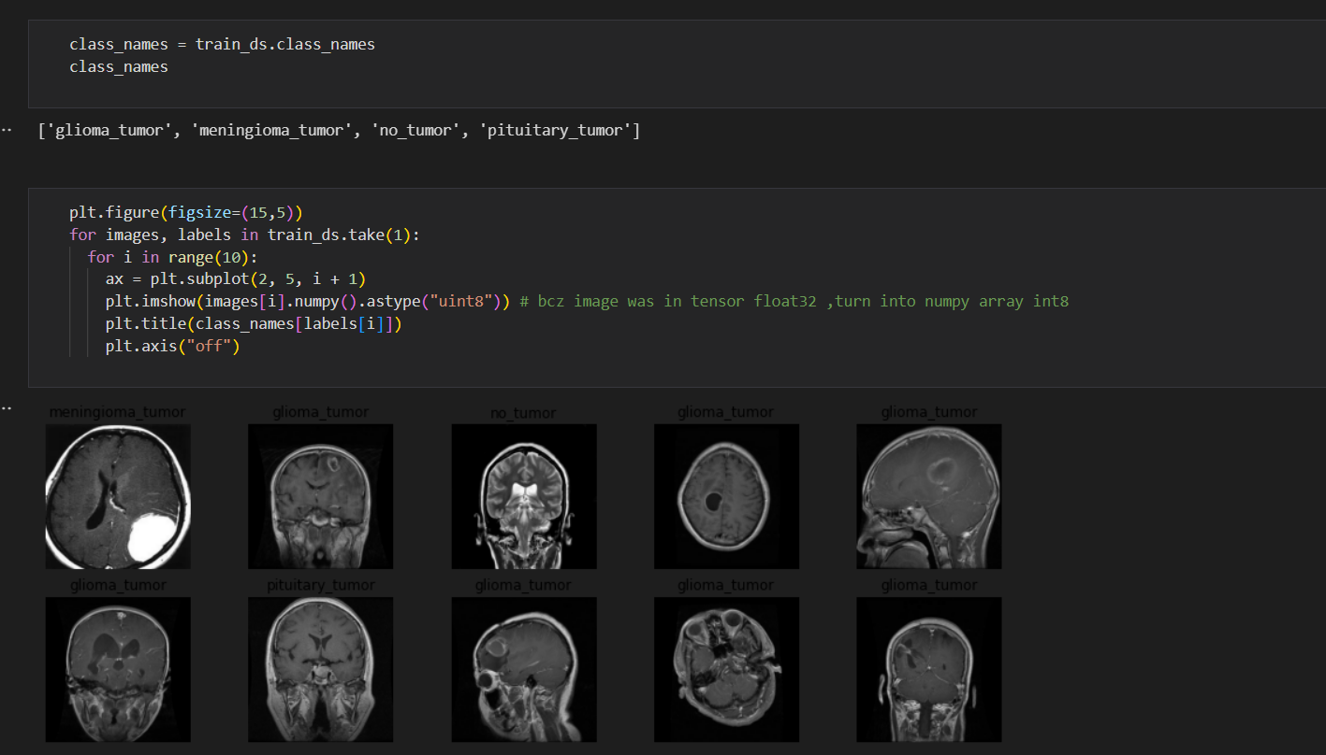
TRAINING DATA FOR MACHINE LEARNING
XCEPTION - Deep learning algorithm

Slide 48
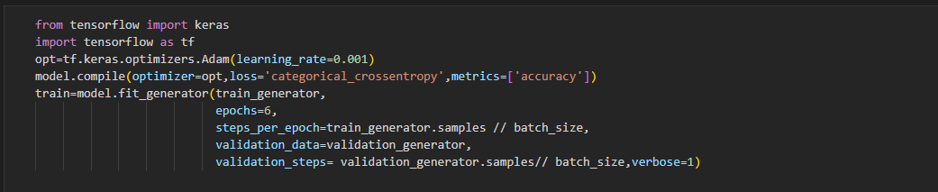
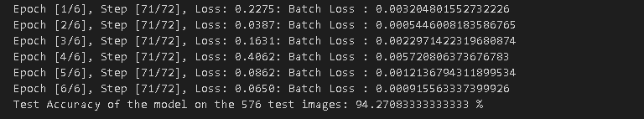
TRAINING MODEL WITH 6 EPOCHS

Slide 49
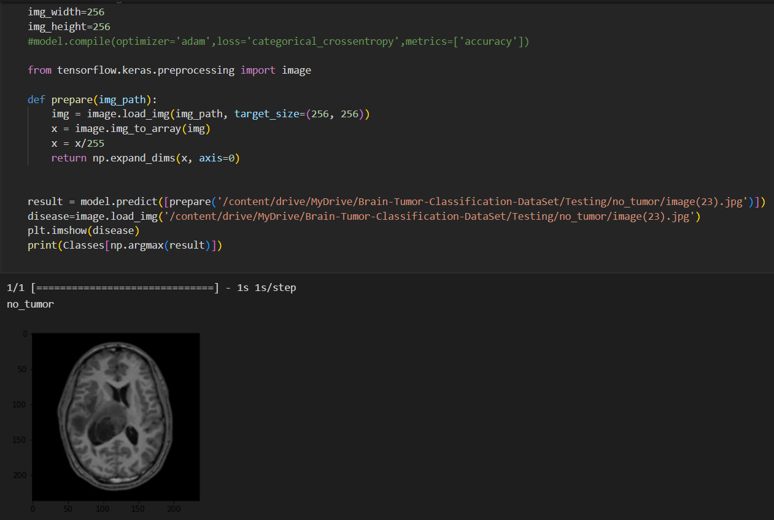
PREDICTION OF IMAGE DATA

Slide 50
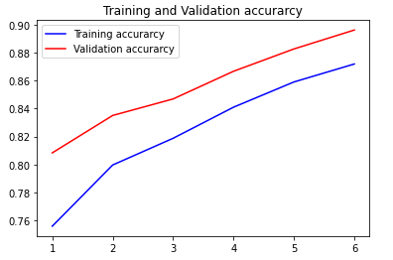
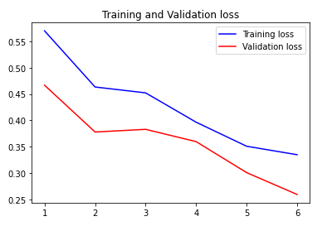
ACCURACY AND LOSS GRAPH
y – axis : Loss
y – axis : Accuracy
x – axis : No. of Epochs
x – axis : No. of Epochs

Slide 51
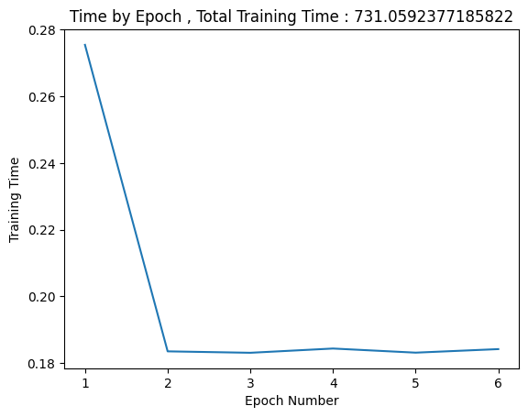
TIME TAKEN FOR 6 EPOCHS

Slide 52
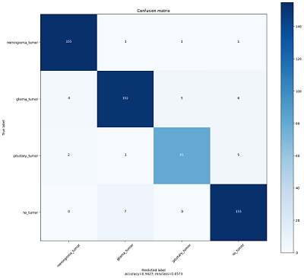
CONFUSION MATRIX

Slide 53
DATASET TRAINED WITH VARIOUS MODELS AND ACCURACY
MODEL | PRECISION | RECALL | F1-SCORE | ACCURACY
AlexNet | 49.15 | 49.02 | 49.11 | 48.99
DenseNet-121 | 93.82 | 93.66 | 93.73 | 93.57
ResNet18 | 92.54 | 91.33 | 91.74 | 91.49
GoogleNet | 92.21 | 92.78 | 92.39 | 92.18
Xception | 94.15 | 93.95 | 94.03 | 94.27

Slide 54
ANALYSIS OF IMAGE ENCRYPTION
Original Image
Encrypted Image

Slide 55
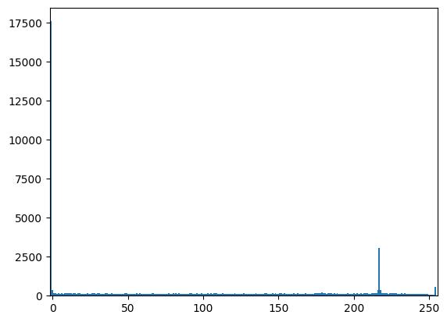
ANALYSIS OF IMAGE ENCRYPTION
Measure | Original Image | Encrypted Image
Entropy | 5.934 | 6.175
PSNR | 29.1166 dB
Correlation Coefficient | Min : 0.31673 Max : 0.31673 Mean : 0.31673
x – axis : color value
y – axis : no of pixels
PLOT OF ENCRYPTED IMAGE

Slide 56
ADVANTAGES
The encrypted image using CRT is more secure than the ordinary image sharing techniques.
Learnability of the encrypted image in deep learning domain increase the accuracy of the image decryption.

Slide 57
REFERENCES
[1] Y. Ke, M. Q. Zhang, J. Liu, T. T. Su, X. Y. Yang, “Fully Homomorphic Encryption Encapsulated Difference Expansion for Reversible Data hiding in Encrypted Domain,” IEEE Transactions on Circuits and Systems for Video Technology, vol. 30, no. 8, pp. 2353 – 2365, Aug. 2020.
[2] Y. Q. Shi, X. Li, X. Zhang, H. Wu, “Reversible Data Hiding: Advances in the Past Two Decades.” IEEE Access, vol.4, no. 5, pp. 3210-3237, May. 2016.
[3] X. Zhang, “Reversible data hiding in encrypted image,” IEEE Signal Processing Letters, vol.18, no. 4, pp. 255-258, Apr. 2011.
[4] K. Ma, W. Zhang, X. Zhao, N. Yu, and F. Li, “Reversible data hiding in encrypted images by reserving room before encryption,” IEEE Trans. Inf. Forensics Security, vol. 8, no. 3, pp. 553–562, Mar. 2013.
[5] J. Zhou, W. Sun, L. Dong, X. Liu, O. C. Au, and Y. Y. Tang, “Secure reversible image data hiding over encrypted domain via key modulation,” IEEE Trans. Circuits Syst. Video Technol., vol. 26, no. 3, pp. 441–452, Mar. 2016.

Slide 58
[6] A meaningful visually secure image encryption scheme -IEEE international conference on big data computing service - 2019
[7] Image security using image encryption and image stitching - 2017 International Conference on Computing Methodologies and Communication (ICCMC)
[8] Image Encryption Algorithm Based on Logistic and Two-Dimensional Lorenz - IEEE Access on Emerging Approaches to Cyber Security
[9] J. Zhou, W. Sun, L. Dong, X. Liu, O. C. Au, and Y. Y. Tang, “Secure reversible image data hiding over encrypted domain via key modulation,” IEEE Trans. Circuits Syst. Video Technol., vol. 26, no. 3, pp. 441–452, Mar. 2016.
[10] Z. Qian, X. Zhang, S Wang, “Reversible data hiding in encrypted JPEG bitstream,” IEEE Transaction on Multimedia, vol.16, no. 5, pp. 1486-1491, May. 2014.
[11] X. T. Wu, J. Weng, W.- Q. Yan. “Adopting secret sharing for reversible data hiding in encrypted images”. Signal Processing, vol.143, pp. 269-281, 2018.

Slide 59
[12] A Prabhanjan, R C Arka, G Aarushi, et al. “Two round information-theoretic MPC with malicious security”, Proc. EUROCRYPT 2019, 532-561, 2019.
[13] Y. C. Chen, T. H. Hung, S. H. Hsieh, et al. “A new reversible data hiding in encrypted image based on multi-secret sharing and lightweight cryptographic algorithms”. IEEE Transactions on Information Forensics and Security, vol. 14, no. 12, pp. 3332-3343, 2019.
[14] M. Chien and J. G. Hwang, “Secret image sharing using (t, n) threshold scheme with lossless recovery,” 2012 5th International Congress on Image and Signal Processing, Chongqing, 2012, pp. 1325-1329.
[15] K. D. Gupta, M. L. Rahman, D. Dasgupta and S. Poudyal, "Shamir's secret sharing for authentication without reconstructing password," 2020 10th Annual Computing and Communication Workshop and Conference (CCWC), Las Vegas, NV, USA, 2020, pp. 0958-0963.

Slide 60
THANK YOU
Notes:
60

